Slide 1
SU-DO-KU
ANAMIKA | FSJ0220A013

Slide 2
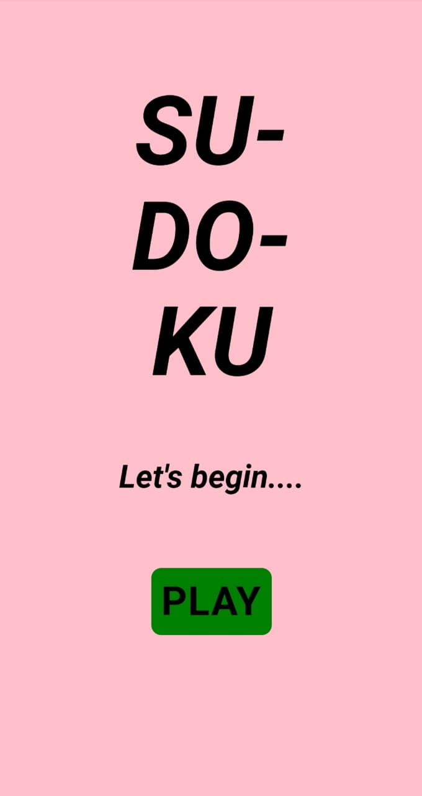
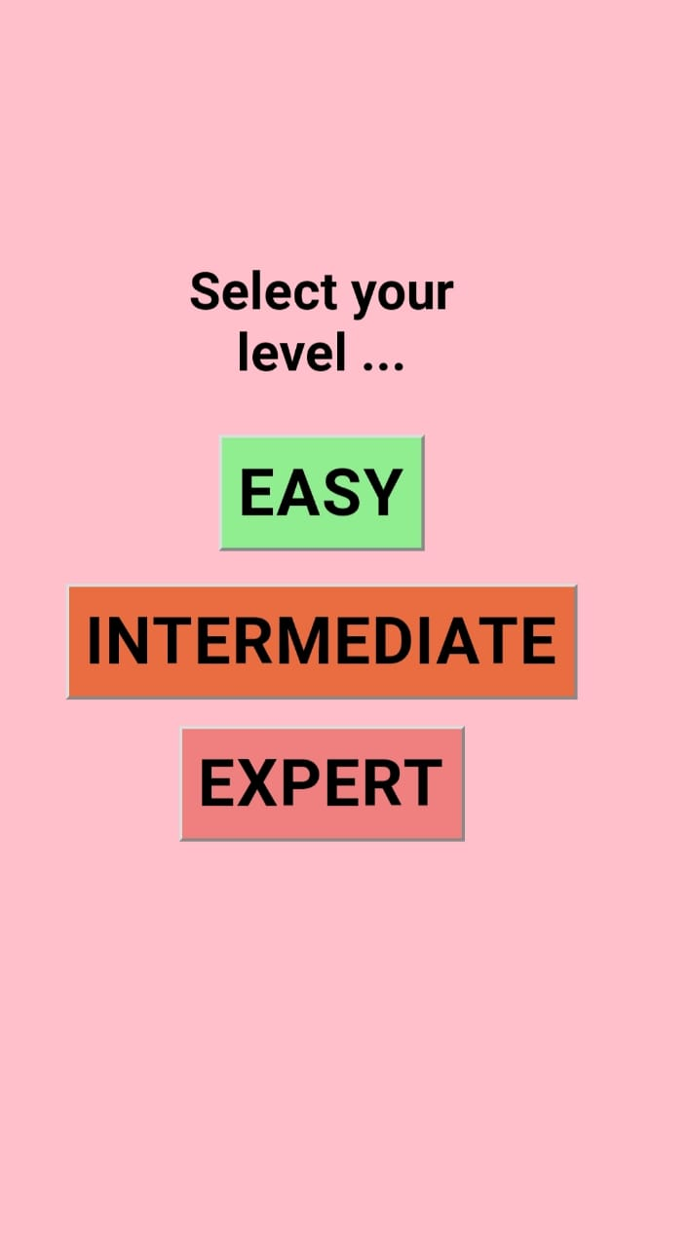
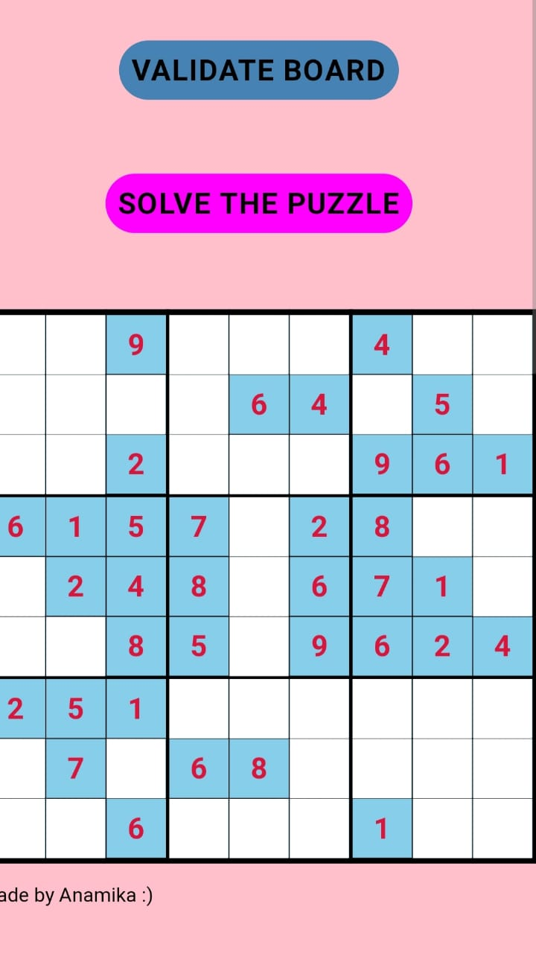
About The Project
A Sudoku puzzle is defined as a logic-based, number-placement puzzle. The objective is to fill a 9×9 grid
with digits in such a way that each column, each row, and each of the nine 3×3 grids that make up the larger 9×9 grid contains all of the digits from 1 to 9. Each Sudoku puzzle begins with some cells filled in.
These are three pages of my game.
.

Slide 3
Why This Project
It’s fun to use your brain. Sudoku is a “brain game” that requires a variety of cognitive skills, such as quick decision making, spotting patterns, and applying logical reasoning. Sudoku gives us a chance to flex our mental muscles in a variety of ways..
Sudoku is a game of momentum. One of the fun aspects of playing Sudoku is
that every single number
that you place on the grid
helps make it easier to solve
the rest of the puzzle –
the game reveals itself as you go on.
Sudoku helps us create order. One of the underrated aspects of solving Sudoku puzzles is that
it is a game of creating order
and solving a puzzle,
in a way that has clear expectations and rules,
and leads to a satisfying result.

Slide 4
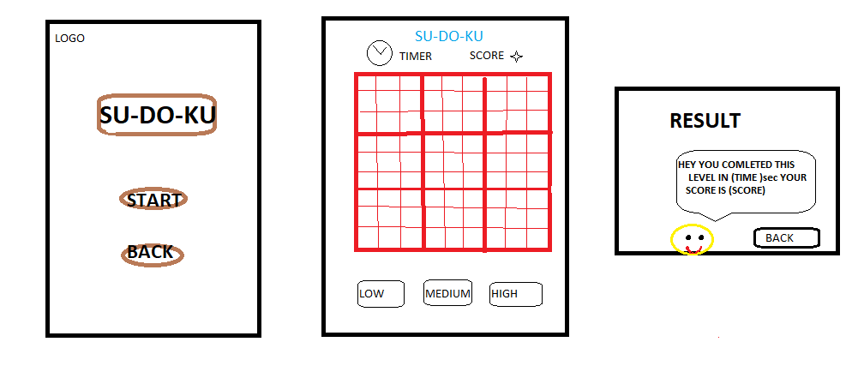
The Project (Wireframe)
.

Slide 5
Concepts Used To Implement This Project
1. Backtracking Algorithm
2. Comparison operator & Loop
3. HTML
4. CSS
5. JavaScript

Slide 6
The Challenges Faced
01
02
03
I faced challenge to generate
Random number in random cell , when we change our sudoku to get unique sudoku everytime and i failed.
I faced challenge to use function for button working from one page to another. But later i resolved.
Whatever problem i faced is all related to Javascript part.
HTML and CSS part is fun for me. Later i will add some animation in sudoku logo.

Slide 7

Thank You

